Slide 1


Predicting Walmart Store Sales with Machine Learning
Retail Store Sales Forecasting
Walmart US Sales from Years: 2010, 2011, 2012
Project 4
Customer Success Team 2

Slide 2


Introduction
2
Walmart's Journey: Being the world’s largest retail corporation, Walmart's growth fascinates researchers and analysts.
Navigating Retail Changes: In an ever-changing retail landscape, predicting sales trends matters for inventory, resources, and meeting customer need.
Our Goal: Build a Machine Learning Model to predict Walmart's future store sales to gather insights.

Slide 3
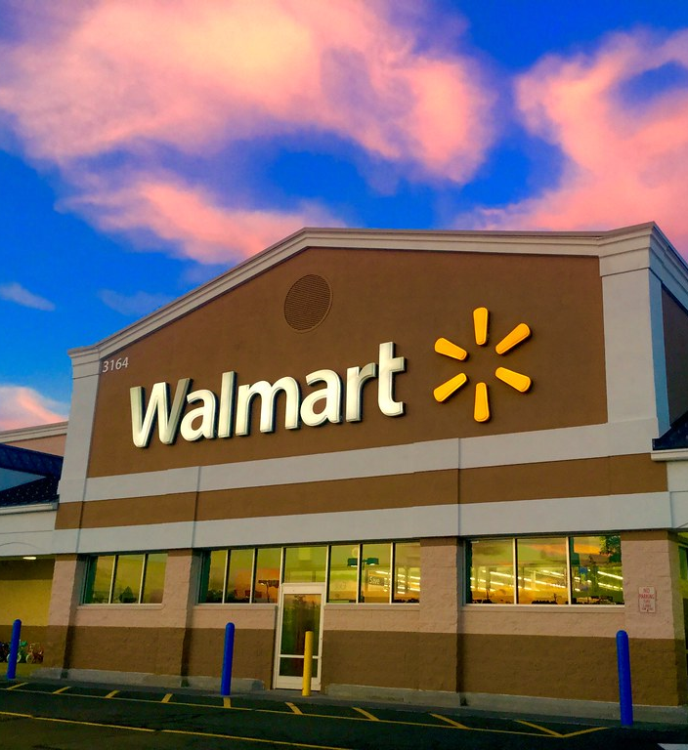
Contents
3
Introduction
Predictive Model Blueprint
Strategy and Approach
Visualizations
Summary of Results
This Photo by Unknown Author is licensed under CC BY

Slide 4
Predictive Model Blueprint
4
Q1
Q2
Q3
Q4
Data Extraction and Preprocessing
After importing our data, we then extracted the dates from our data frame in order to plot weekly sales on a line chart for 3 years of sales data.
Model and Features
We trained our model with XG Boost in order to predict future Walmart sales so that Walmart can use it in their business decisions.
For example, knowing the lowest days of sales and devising a plan to increase profit.
Testing and Training
For our first model we split the data into testing and training sets and ran the first model with 100 rounds.
Model Optimization
We optimized the model by dropping the Day Month and Store columns from the DataFrame and reran the model.

Slide 5
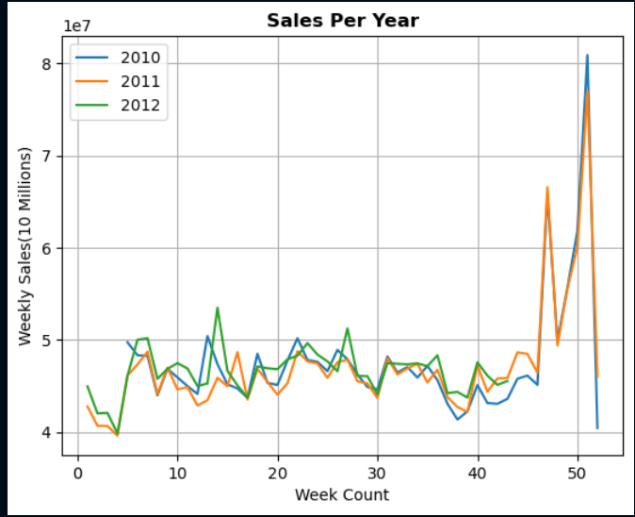
Walmart Sales (Year to Year)
5
Walmart Sales from 02-05-2010 to 11-01-2012
Line chart that shows Walmart’s US Store Sales Trendlines from the years 2010-2012
Shows the Sales are consistent and has a small pattern amongst the three years

Slide 6
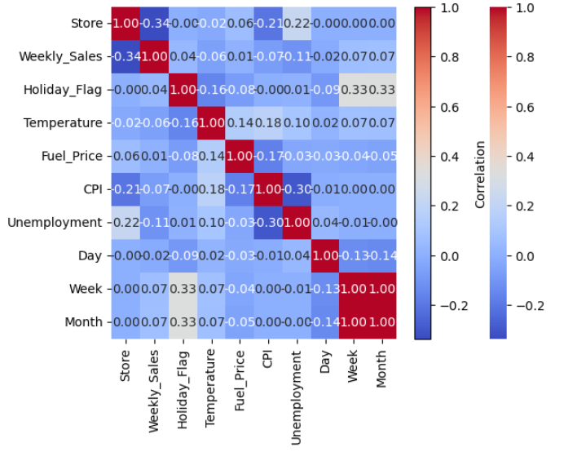
Correlation Matrix
6
Identifying trends – Walmart Sales and Key Factors
Explores the relationships between Walmart's weekly sales and key influencing factors.
Powerful visual representation that helps us understand how different variables are related to each other.
Exemplifies we don't need month and days since they were highly corelated, so we decided to drop it for pre-processing

Slide 7
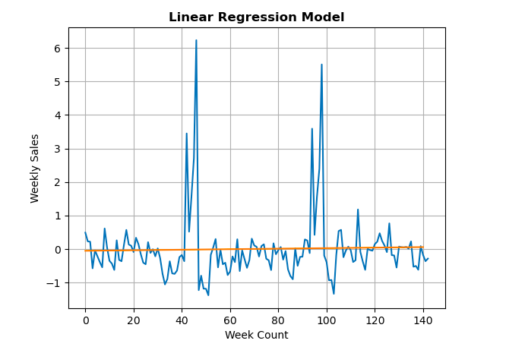
Linear Regression
7
About our Model
Designed to analyze Walmart's sales data.
Points have wide degree of variance making it very difficult to predict with Linear Model
This model predicts sales to be increasing very slightly as a whole, but sales for a given week would be difficult to predict.

Slide 8
Pre-Processing
8
Standard Scaler
In order to process our data, we used Standard Scaler to preprocess the input features before training our predictive model.
Standard Scaler was used to drop the columns , “Day”. “Month”, and “Store.” Dropping these columns cleaned our dataset and allowed us to focus on sales at the week level.
Outliers within sales data can adversely effect model training. By eliminating the mean and adjusting the scale, Standard Scaler counteracted the influence of outliers, and made our Walmart sales prediction model more robust.

Slide 9
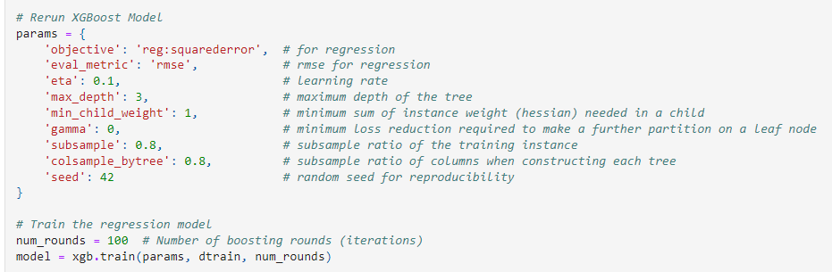
XGBoost (Extreme Gradient Boosting) designed for both regression and classification tasks.
9
Defines a set of options for our machine learning model.
Here, we're telling the model to learn from the data.
XG Boost Predictive Model
Notes:
It's like giving instructions to the model on how to learn from data. We reached a high percentage of accuracy which is why we didn’t optimize it.

Slide 10
This code sets up an XGBoost regression model
trains it on the provided training data
evaluates its performance using the RMSE (Root Mean Squared Error) metric
10
Defining a set of options for our machine learning model.
Here we ask the model to study the data and adjust its understanding to make better predictions.
XG Boost Predictive Model

Slide 11

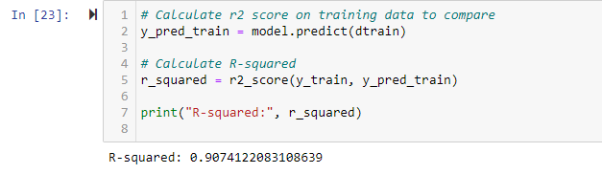
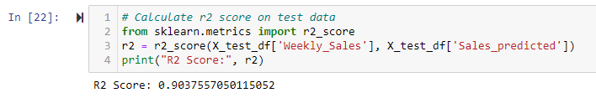
Calculating & Comparing R-squared on Test Data and on Training Data:
11
High Accuracy
No overfitting

Slide 12
Optimizing our Model
12
For the first model run, our r² score was 0.93. This means that it is a good model for predicting future Walmart Sales. Additionally, to achieve the highest level of accuracy, we optimized our model.
After optimizing the model the r² score was the same as the first model run

Slide 13






Summary of Results
13
Achieved 90% accuracy
Empowers decision-makers with precise predictions for better resource allocation.
Competitive Advantage
Providing a competitive edge through accurate anticipation of market trends.
Optimized Inventory Management
Optimizing inventory and stock management to enhance customer satisfaction.
Enhances Marketing Strategy
With accurate sales predictions, decision-makers can better tailor marketing strategy.
Identify Trends in Consumer Behavior
Helps recognize recurring patterns within the dataset; as well as examine connections between factors and variables.
Data Driven Decision Making
Capitalizing on data-driven insights to meet seasonal trends and customer demands effectively.

Slide 14
Meet Our Team
14
Reid Hyman
Nicole Howell
Michael DiBartolo
Matthew Panganiban

